Slide 1
BLOG WEBSITE DEVELOPMENT

Slide 2

Blog:
Blog, in full Web log or Weblog, online journal where an individual, group, or corporation presents a record of activities, thoughts, or beliefs.
LMS Username | Name | Batch
2115a547 | SWEATHA P | A5
2115a555 | VINDIYAVASINI S | A5
2115a545 | SUJITHRAH K | A5
2115a551 | VAGULA VARSHINI L | A5

Slide 3

TABLE OF CONTENTS
1.INTRODUCTION
1.1 OBJECTIVE
1.2 SCOPE
1.3 GLOSSARY
2. OVERALL DESCRIPTION
2.1 PROJECT PERSPECTIVE
2.2 HARDWARE REQUIREMENTS
2.3 SOFTWARE REQUIREMENTS
2.4 FUNCTIONAL REQUIREMENTS
2.4.1 USER REGISTRATION AND AUTHENTICATION
2.4.2 CONTENT MANAGEMENT SYSTEM
2.4.3 SEARCH FUNCTIONALITY
2.4.4 COMMENTING SYSTEM
2.4.5 CATEGORIES AND TAGS
2.4.6 RSS FEEDS
2.4.7 SOCIAL MEDIA INTEGRATION

Slide 4
2.5 NON FUNCTIONAL REQUIREMENTS
2.5.1 SCALABILITY
2.5.2 PRIVACY
2.5.3 ROBUSTNESS
2.5.4 PERFORMANCE
3. USER CHARACTERISTICS
4. DIAGRAM
4.1 USE CASE DIAGRAM
4.2 CLASS DIAGRAM
4.3 ACTIVITY DIAGRAM
4.4 SEQUENCE DIAGRAM
4.5 DATA FLOW DIAGRAM
5. REFERENCES

Slide 5
1.INTRODUCTON
Blog website development involves the creation of a website specifically designed to publish, organize and share written content, images, and other multimedia material. A blog website serves as a platform for writers, journalists, organizations, and individuals to express their ideas, opinions, and share their knowledge on various topics. Blog websites often have a content management system that allows the author to easily write and publish content without requiring technical knowledge.
1.1 OBJECTIVE
Increase User Engagement: This could involve developing features such as a commenting system, social media integration, and a subscription feature to encourage readers to engage with the website and its content.
User friendliness: The project should be very easy to use enabling even a novice person to use it.

Slide 6
1.2 SCOPE
The scope of a blog website development project can vary depending on the goals and objectives of the website owner. Generally, a blog website development project involves creating a platform for the website owner to publish their thoughts, ideas, and opinions on a particular topic or a range of topics. This may include features such as a blog post editor, comment section, social media integration, and search functionality. Additionally, a blog website may require design customization, SEO optimization, and mobile responsiveness to ensure a user-friendly and visually appealing experience for visitors.
1.3 GLOSSARY
GUI - Graphical User Interface
API - Application Programming Interface
PHP - Hypertext Pre-Processor
CSS - Cascading Style Sheet
XML - Extensible Markup Language
XHTML - Extensible Hypertext Markup Language
JS – JavaScript
WP – WordPress

Slide 7
2.OVERALL DESCRIPTION: 2.1 PROJECT PERSPECTIVE
A project perspective for a blog website development project involves considering the project's goals, objectives, timeline, and resources required for successful completion. From a project perspective, it is important to establish a clear understanding of the project's scope and requirements, including any specific design elements, functionality, or features needed. It is also important to define the project timeline and milestones to ensure that the project is completed within the expected timeframe. A project perspective may also involve identifying the resources needed for the project, including the necessary technology, software, and personnel required. This may involve hiring a web developer or a team of developers, graphic designers, or content creators, depending on the needs of the project. Additionally, a project perspective may require a review of the budget and cost estimates to ensure that the project is financially feasible.
2.2 HARDWARE REQUIREMENTS
Computer or laptop with a minimum of 4 GB RAM and a dual-core processor.
A high-speed internet connection for fast file transfers and website testing.
A backup solution to ensure website data is protected in case of hardware failure.
A reliable power supply to prevent data loss due to sudden power outages.

Slide 8
2.3 SOFTWARE REQUIRMENTS
The software requirements for a blog website development project include a text editor or IDE, a web development framework or platform, and a database management system. Additionally, a web server and version control system may be needed. It is important to select reliable and well-supported software tools for a stable and secure website.
2.4 FUNCTIONAL REQUIREMENTS
a) User Registration and Authentication
The website should allow users to create accounts and log in securely. This can be done through email and password or social media accounts.
b) Content Management System
The website should have a CMS that allows content creators to write, edit and publish blog posts, as well as add images, videos, and other multimedia content.
c) Search Functionality
Users should be able to search for blog posts based on keywords, tags, and categories.

Slide 9
d) Commenting System The website should have a commenting system that allows users to leave comments on blog posts. e) Categories and Tags The website should have a system for categorizing blog posts by topic and using tags to make them easier to find. f) RSS Feeds The website should offer RSS feeds to enable readers to subscribe to new blog posts. g) Social Media Integration The website should allow users to share blog posts on social media platforms such as Twitter, Facebook, and LinkedIn.

Slide 10
2.5 NON FUNCTIONAL REQUIREMENTS
2.5.1 Scalability
Ability to handle increased traffic & data without compromising performance or functionality.
2.5.2 Privacy
The protection of user data and the website's compliance with privacy laws and regulations.
2.5.3 Robustness
The website's ability to handle errors, failures, and unexpected events without crashing or malfunctioning.
2.5.4 Performance
The speed, responsiveness, and overall efficiency of the website's functionality and user interface.
3.USER CHARACTERISTICS:
Content Consumers: Users who primarily visit the website to read and consume content.
Content Creators: Users who create and publish content on the website. These users may be writers, journalists, or experts in a particular field who want to share their knowledge and ideas with a wider audience.
Social Media Users: Users who access the website through social media platforms such as Facebook, Twitter, and Instagram.
Mobile Users: Users who access the website using mobile devices such as smartphones and tablets.

Slide 11
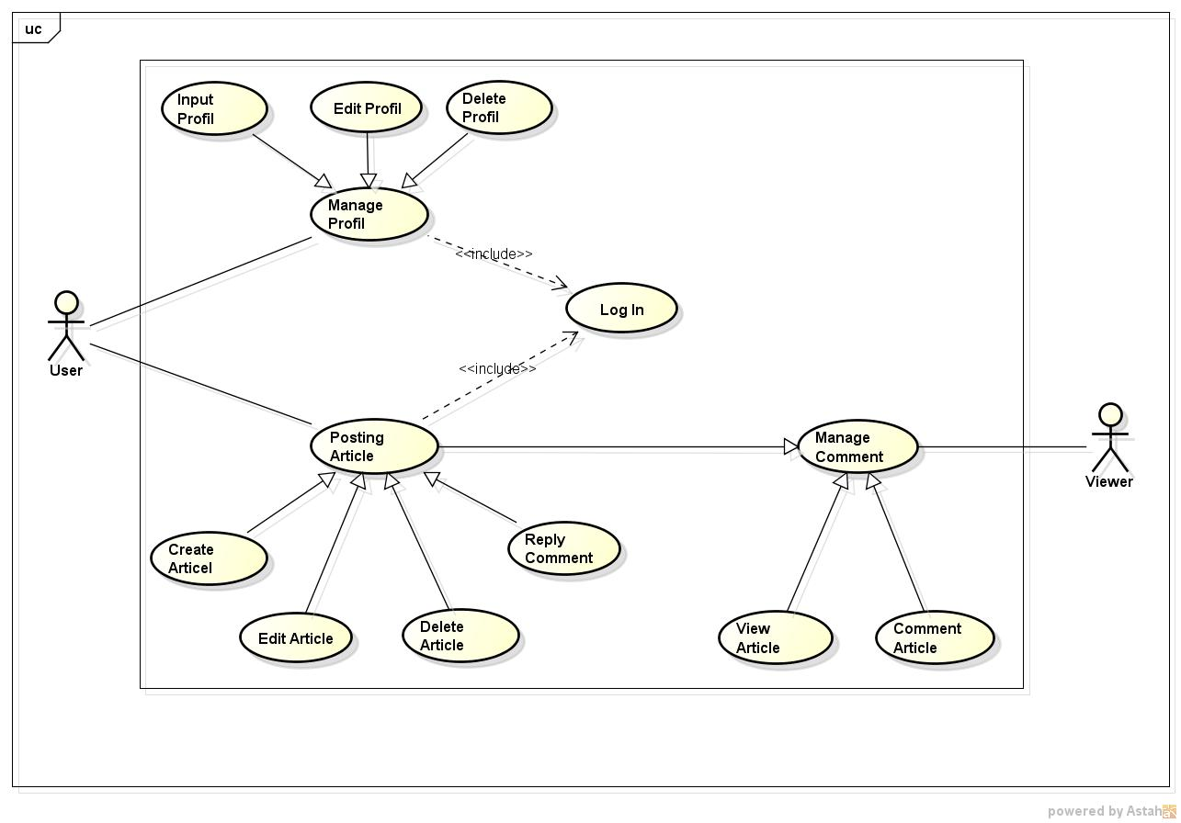
4.DIAGRAMS: 4.1 USE CASE DIAGRAM

Slide 12
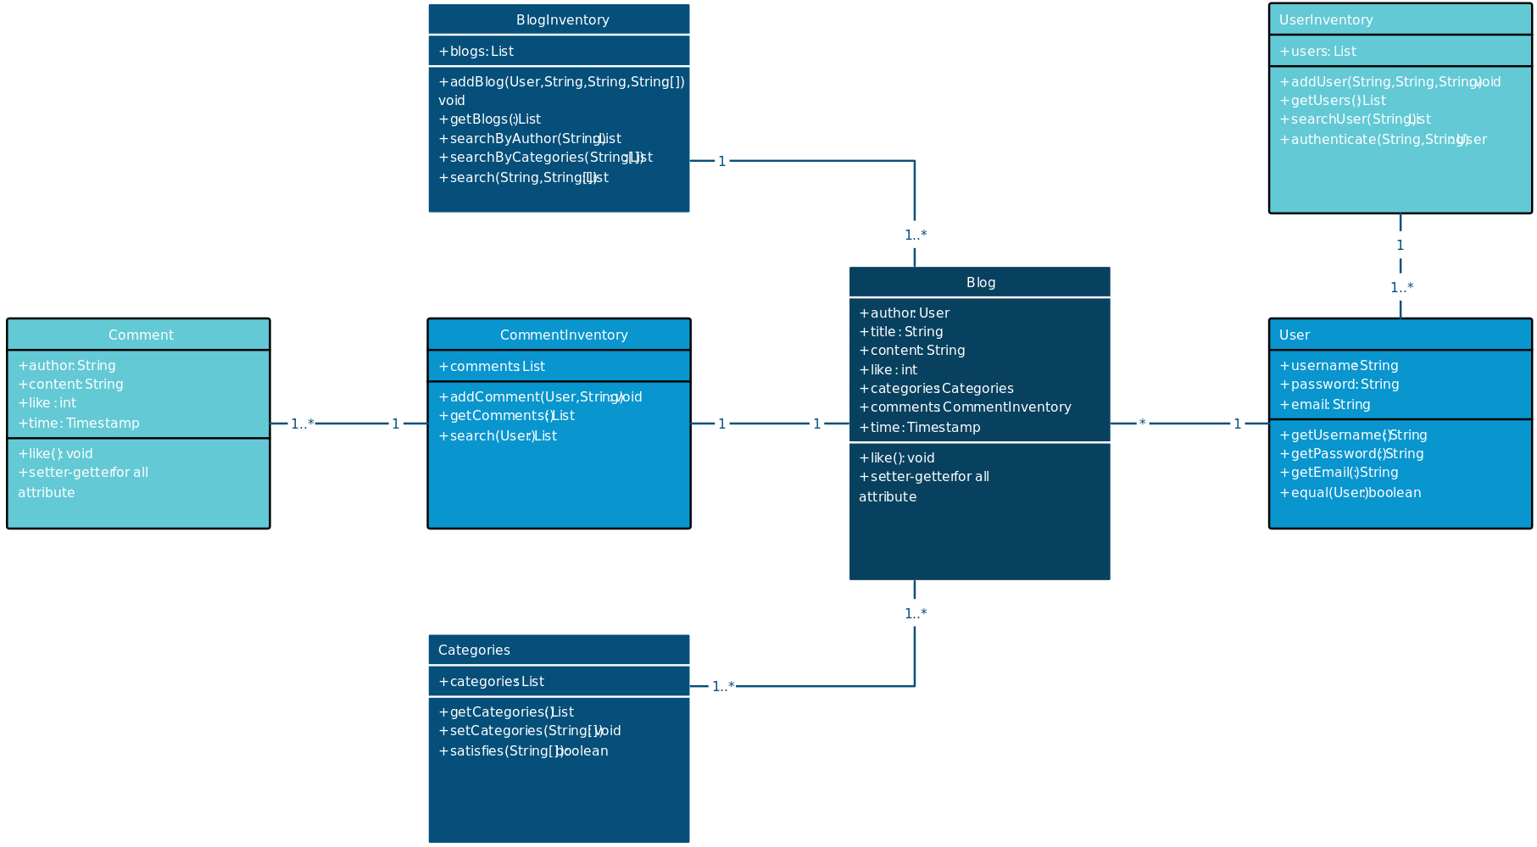
4.2 CLASS DIAGRAM

Slide 13
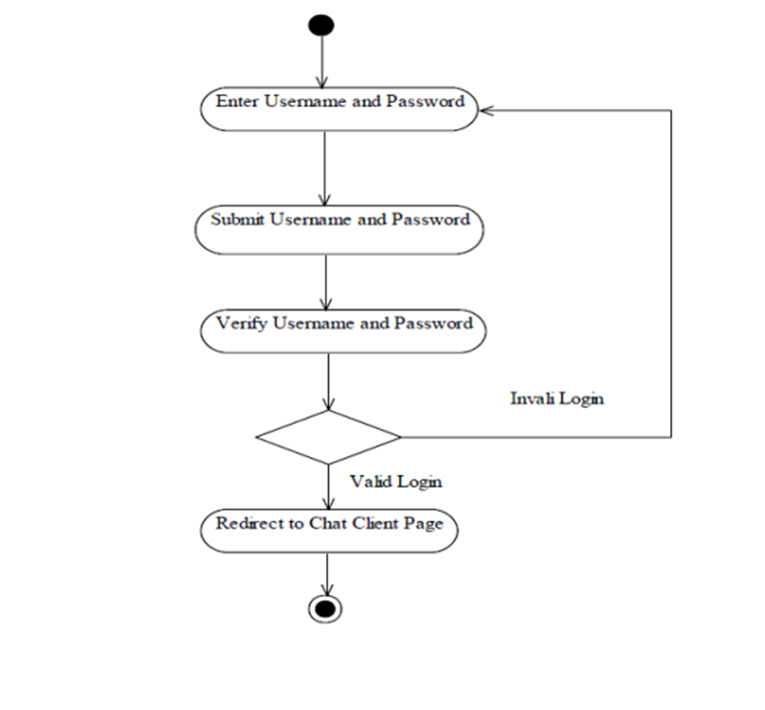
4.3 ACTIVITY DIAGRAM LOGIN

Slide 14
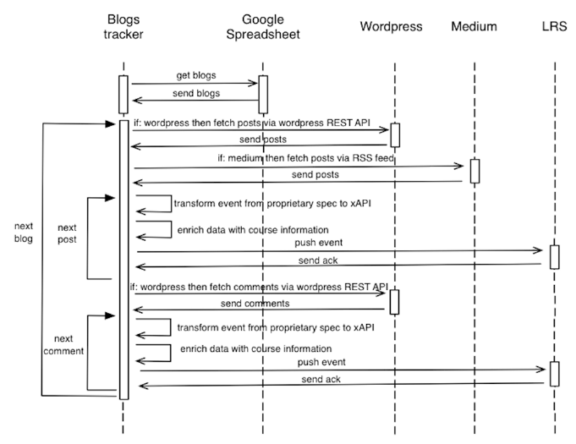
4.4 SEQUENCE DIAGRAM

Slide 15
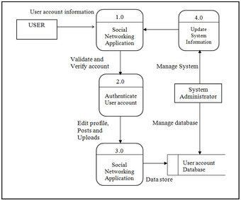
4.4 DATA FLOW DIAGRAM

Slide 16
5. REFERENCES:
WW.GOOGLE.COM
"WordPress for Beginners 2021: A Visual Step-by-Step Guide to Mastering WordPress" by Dr. Andy Williams
"Building Websites All-in-One For Dummies" by David Karlins
"Web Design with HTML, CSS, JavaScript and jQuery Set" by Jon Duckett
"The Elements of User Experience: User-Centered Design for the Web and Beyond" by Jesse James Garrett
"Search Engine Optimization All-in-One For Dummies" by Bruce Clay and Susan Esparza

Slide 17
GITHUB LINK
https://github.com/Sweatha154/group_1_A5.git
https://github.com/Tanzeera/Group/A5/4.git

